Slide 1

Securing Organizations Using Honeypots
BY:
Syed Irfan
Sanaullah

Slide 2
Agenda
Honeypots Introduction
Detecting Honeypots
c
H
Types of Honeypots
Low-Interaction Honeypots
T
High-Interaction Honeypots
n
D

Slide 3


Honeypots
Honeypots is a network-attached system used as a trap for cyber-attackers to detect and study the tricks and types of attacks used by hacker

Slide 4
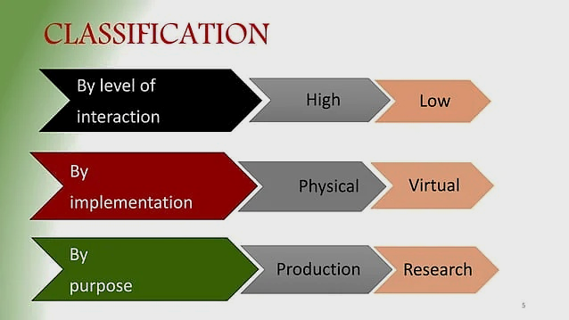

Slide 5
Physical Honeypots
A physical honeypot is running on a real machine connected to the network using its own assigned IP address
Physical Honeypots
C
By Implementation
Virtual Honeypots
f
Virtual Honeypots
A virtual honeypot is a fake network designed by computer experts to catch hackers and examine their methods of attack.

Slide 6
High Interaction Honeypots
A high-interaction honeypot allows attackers to compromise or gain access to the system.
High Interaction Honeypots
C
By Level of interaction
Low interaction Honeypots
f
Low interaction Honeypots
A low-interaction honeypot simply captures connection attempts and alerts the security team an intrusion has been attempted

Slide 7

Production Purpose
A production honeypot is a type of honeypot that’s used to collect cybersecurity-related information within a business’s or organization’s production network.
Production Purpose
C
Research Purpose
f
By Purpose
Research Purpose
A type of honeypot that’s used to collect information about the specific methods and tactics hackers use.
e.g military, researcher ,
government organization

Slide 8
Divert Malicious Traffics from important system
Why an organization use honeypots ?
01
Get an early warning before critical system are hit
02
Gather information about attacker and their method
03
04
Cost Effective

Slide 9
Detecting
Detecting Honeypots
Honeypot is designed primarily for tracking or attacking attackers during their attempts to break into an organization system.

Slide 10
Detecting
User-Mode Linux
Running on VMware
Honeyd Honeypot
Fake AP
User-Mode Linux
01
Attackers can identify the presence of UML honeypots by analyzing files such as
/proc/mounts,
/proc/interrupts, and
/proc/cmdline,
which contain UML-specific information..

Slide 11
Detecting
User-Mode Linux
Running on VMware
Honeyd Honeypot
Fake AP
Running on VMware
02
Attackers can detect instances that are running on the VMWare virtual machine by analyzing the MAC address. Referring to IEEE standards for the current range of MAC addresses assigned to VMWare Inc., an attacker can identify the presence of VMWare-based honeypots.

Slide 12
Detecting
User-Mode Linux
Running on VMware
Honeyd Honeypot
Fake AP
Honeyd Honeypot
03
Honeyd is a simulator honeypot engine that can create thousands of honeypots easily. The honeyd would respond to received SMTP requests with fake responses. An attacker can identify the presence of honeyd honeypot by performing time-based TCP fingerprinting methods.

Slide 13
Detecting
User-Mode Linux
Running on VMware
Honeyd Honeypot
Fake AP
Fake AP
Honeypot
04
Fake access points send only beacon frames but do not produce any traffic on the access points, and an attacker can detect and monitor the network traffic and quickly note the presence of fake AP.

Slide 14
Detecting
Relax
Boys & Girls

Slide 15
Thank You

